Slide 1
Tips When Doing CAD Collaboration
李岱峰，17机器人工程
2020.07.22

Slide 2
Sketches
Fully define sketches. All BLACK, no BLUE.
DO NOT use “Fully Define Sketch” button
Use equations, relations, and general variables
Use relation definitions (for example, “=”), or define variables
Dimension rectangles from the edges, not the corner
Make separate features in separate sketch unless it’s master sketch from top-down
Use symmetrical relations
Put origin at a mounting location (or center point)
Use construction lines to help define sketch (less unnecessary trim）
3D Sketch - 2D first then having 3D sketch come off of that

Slide 3
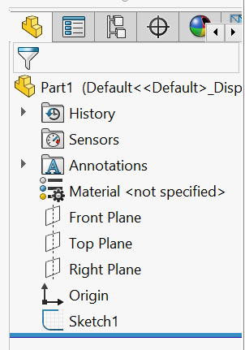
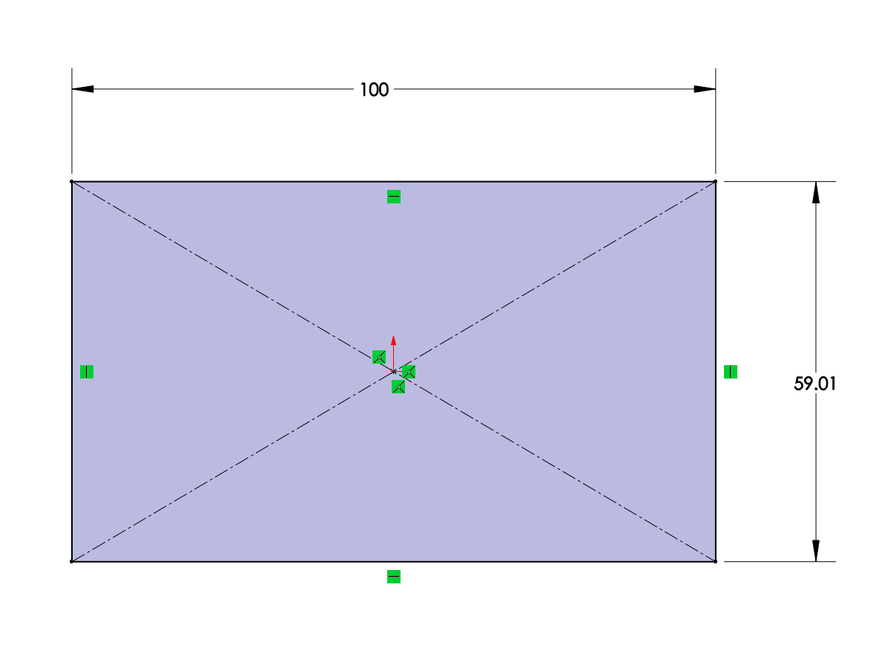
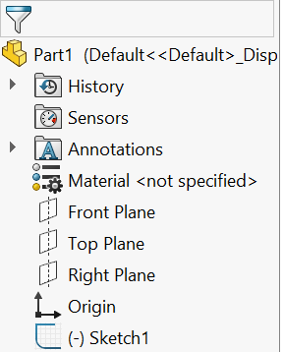
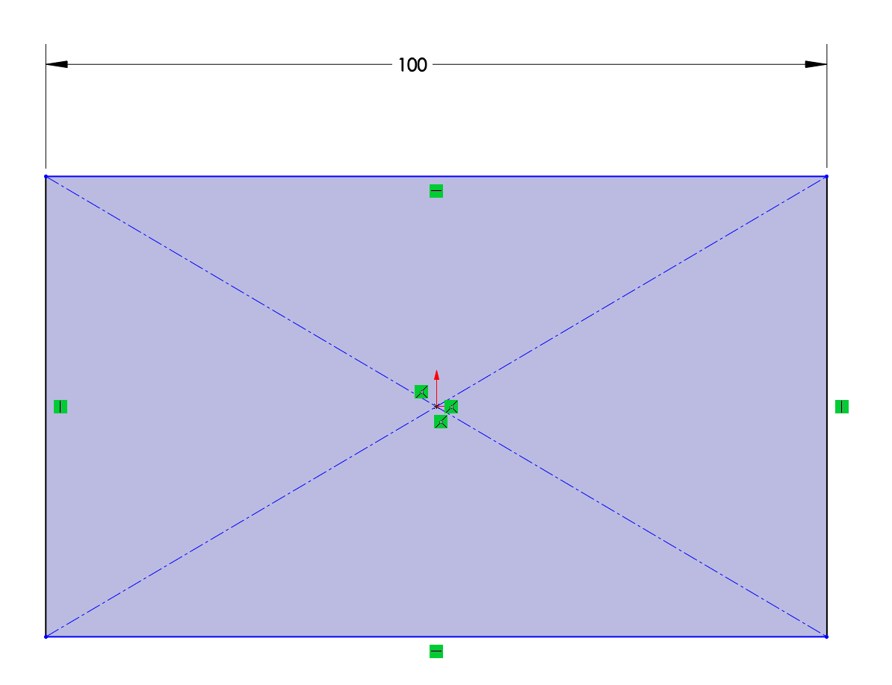
Sketch - Fully Define Sketches

Slide 4
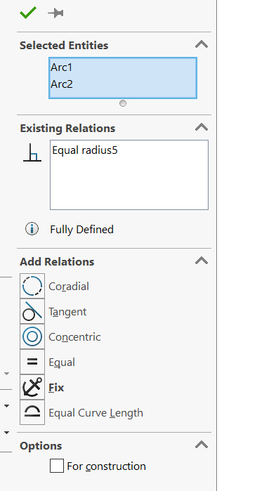
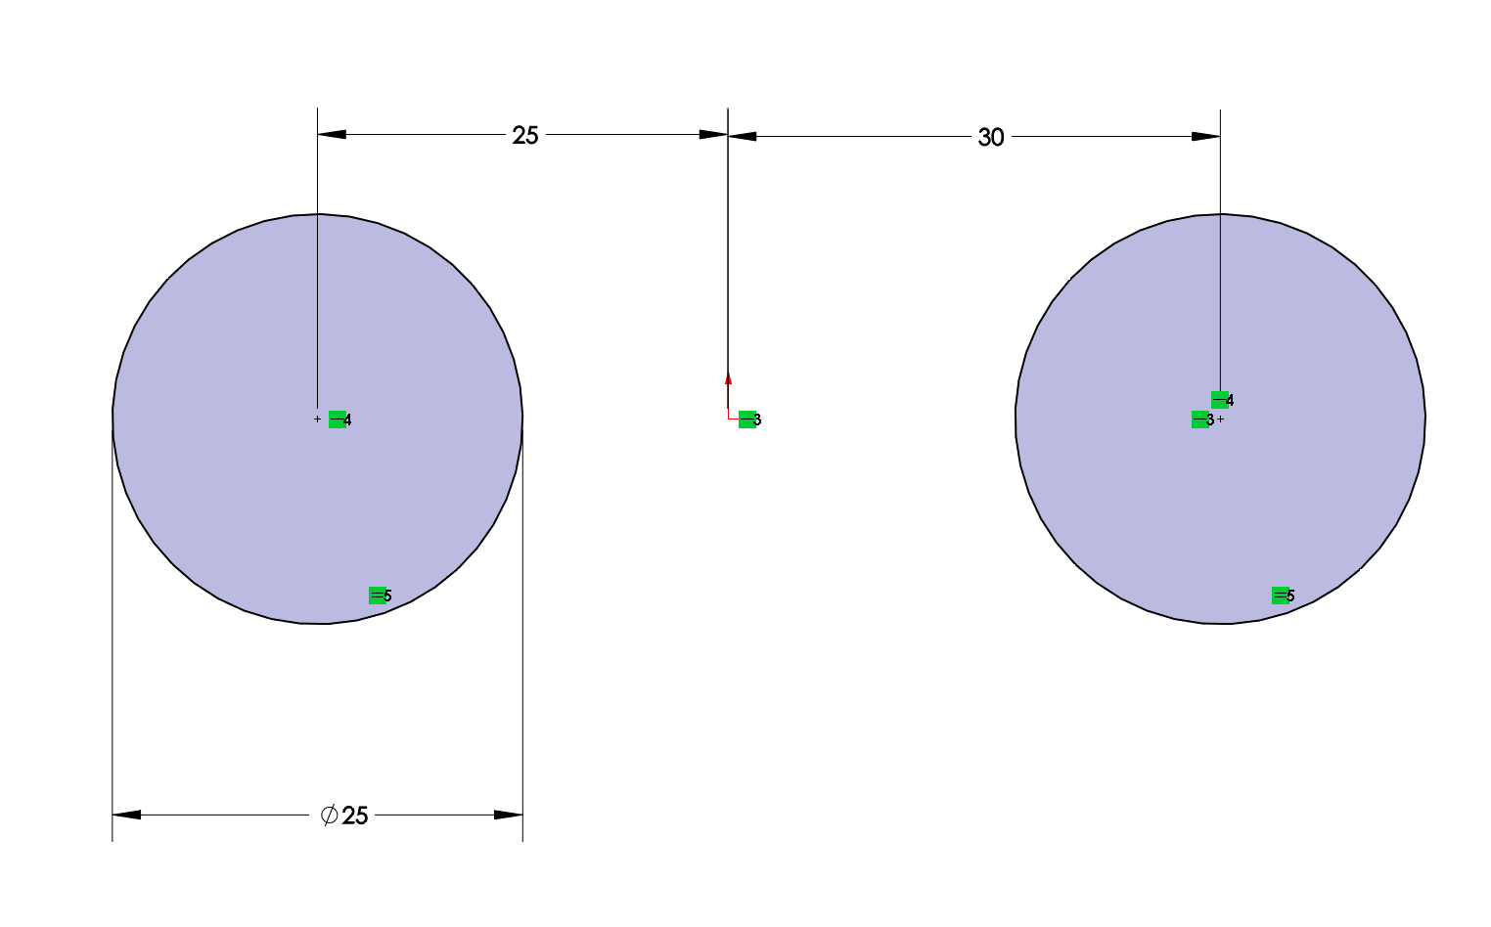
Sketch - Combine Common Dimensions

Slide 5
Sketch - Dimensioning Rectangles
Demonstration
Notes:
Example of why, what’s gonna happen if not

Slide 6
Use Construction Lines
Also:
-Symmetrical Relation
-Origin

Slide 7
Parts
Use symmetry whenever possible
Use configuration when possible
Make features like when it’s being machined
Name useful dimensions and features
Especially when those dimensions are referenced
Make several simple features instead of one complicated feature. (More robust and easy to edit)
Use fillet features instead of sketch fillets
Apply cosmetic fillet and chamfer last

Slide 8
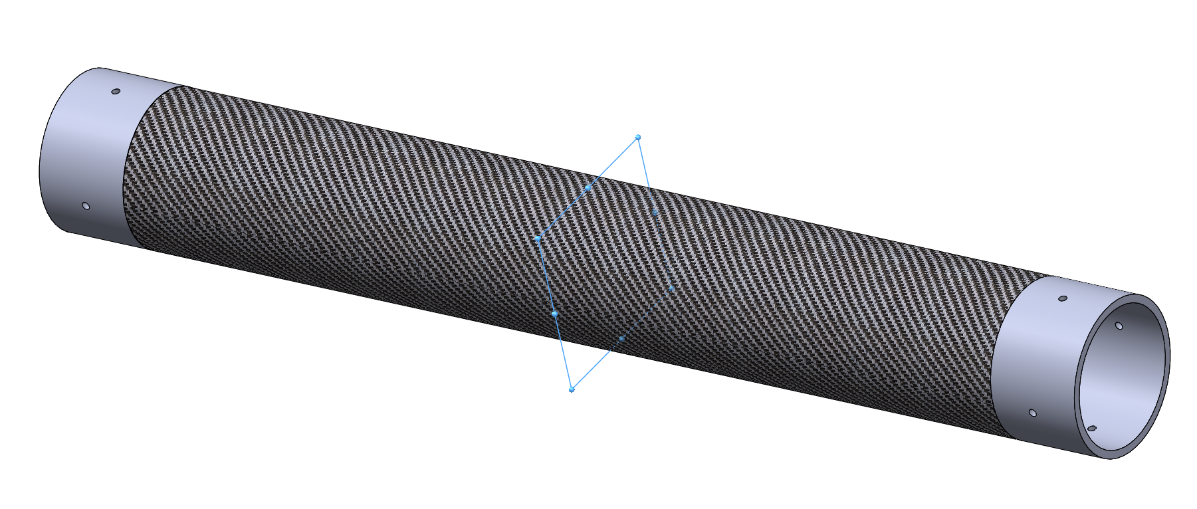
Use Symmetrical Relations

Slide 9
Use Configuration
Demonstration
Notes:
有可变参数的时候

Slide 10
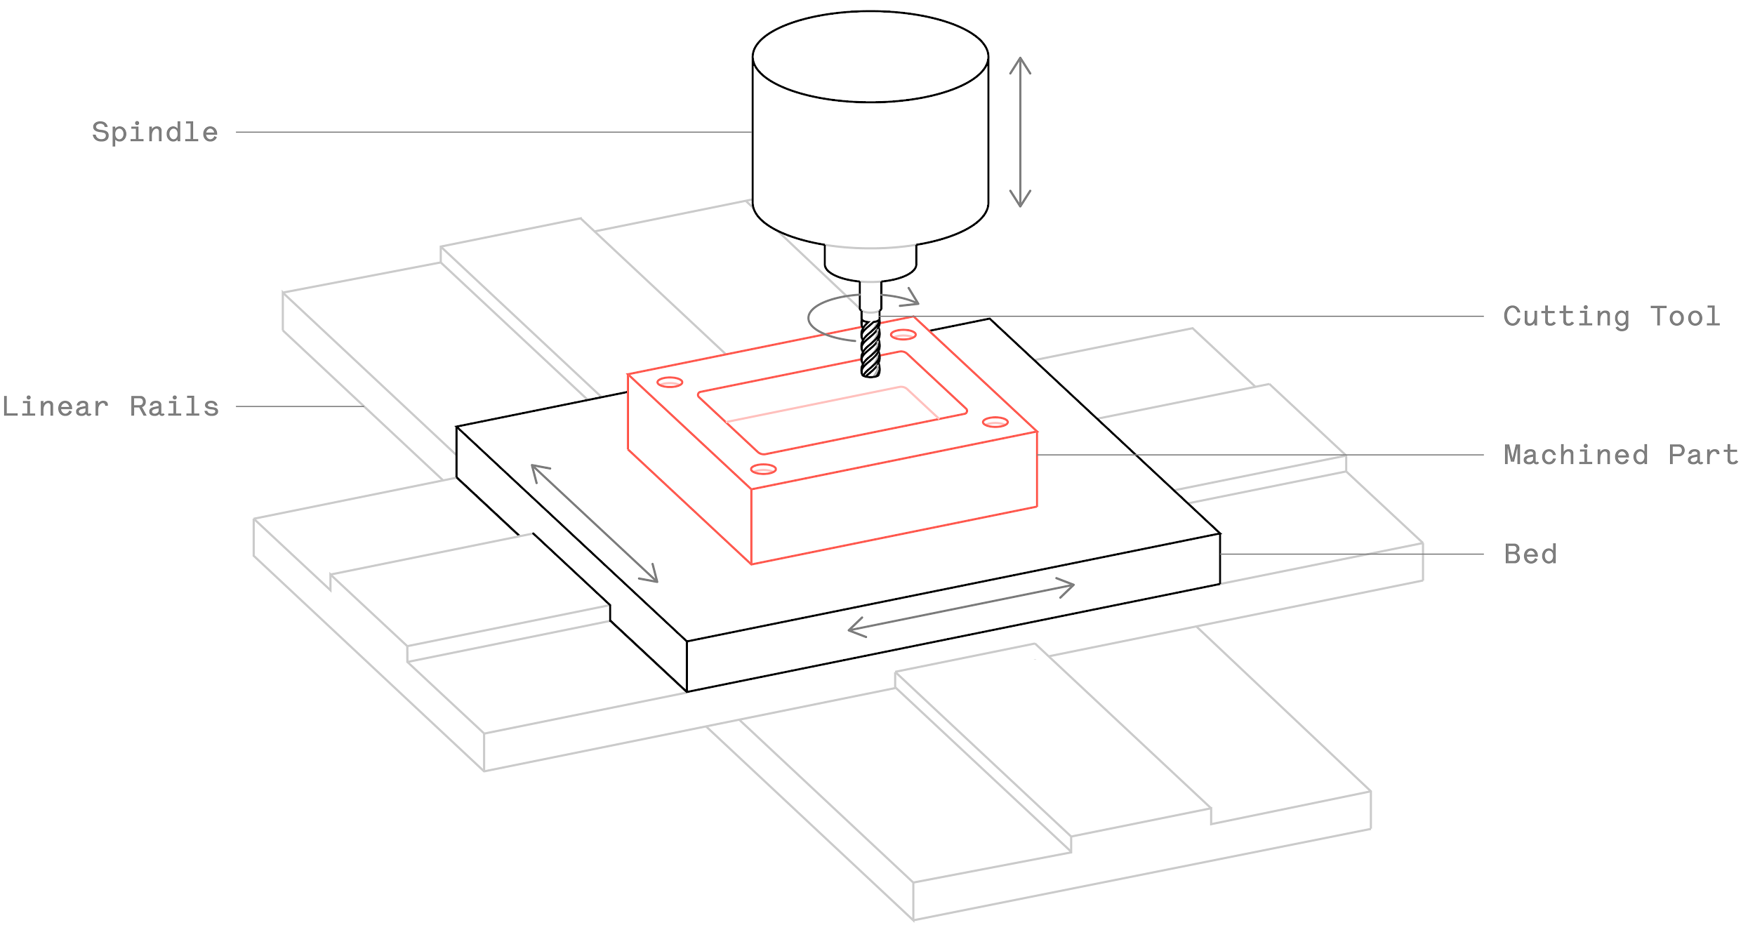
Make features Like Being Machined（not necessary for you now）
Even better, if you dimension it as being machined
Notes:
比如，这个方块的槽数值edge不能是sharpe的

Slide 11
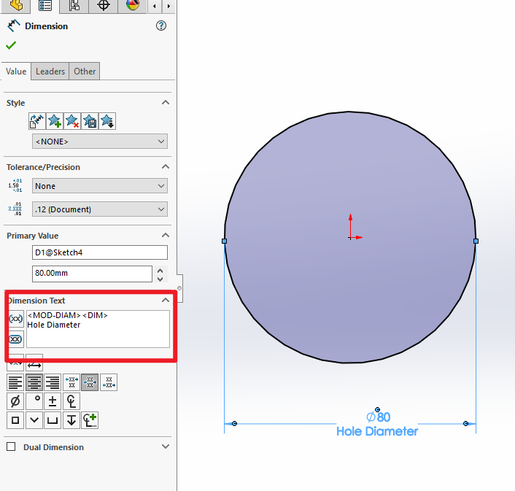
Label Important Dimensions

Slide 12
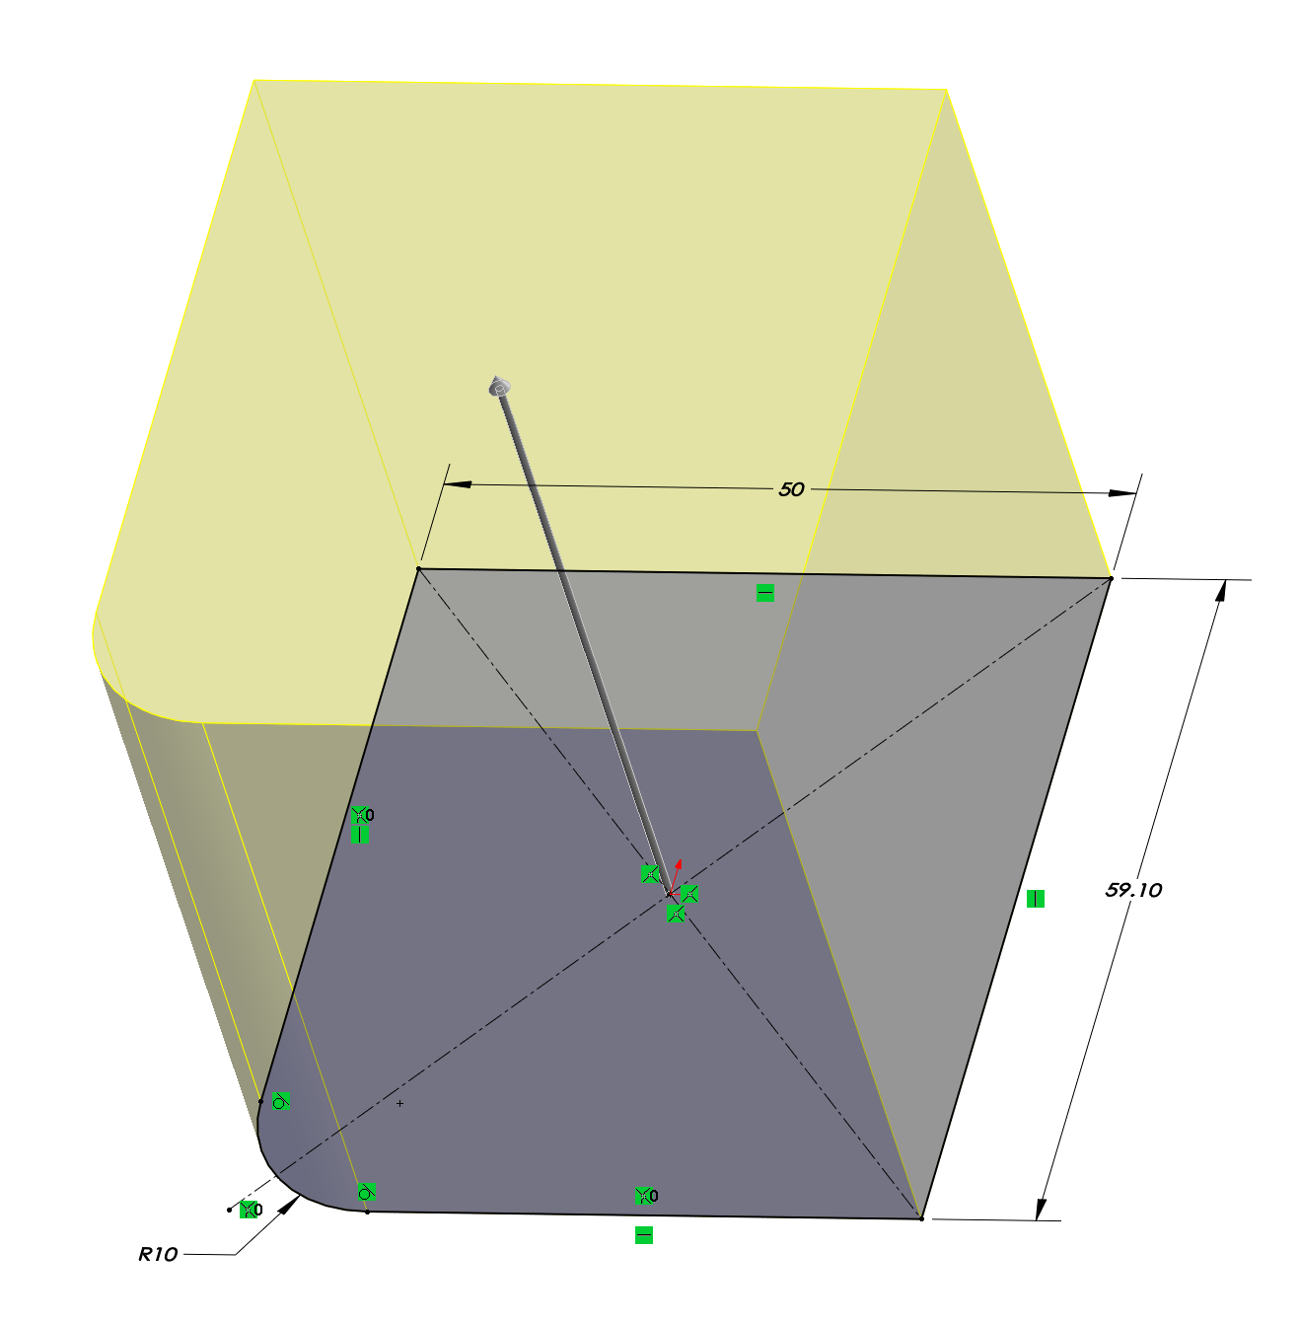
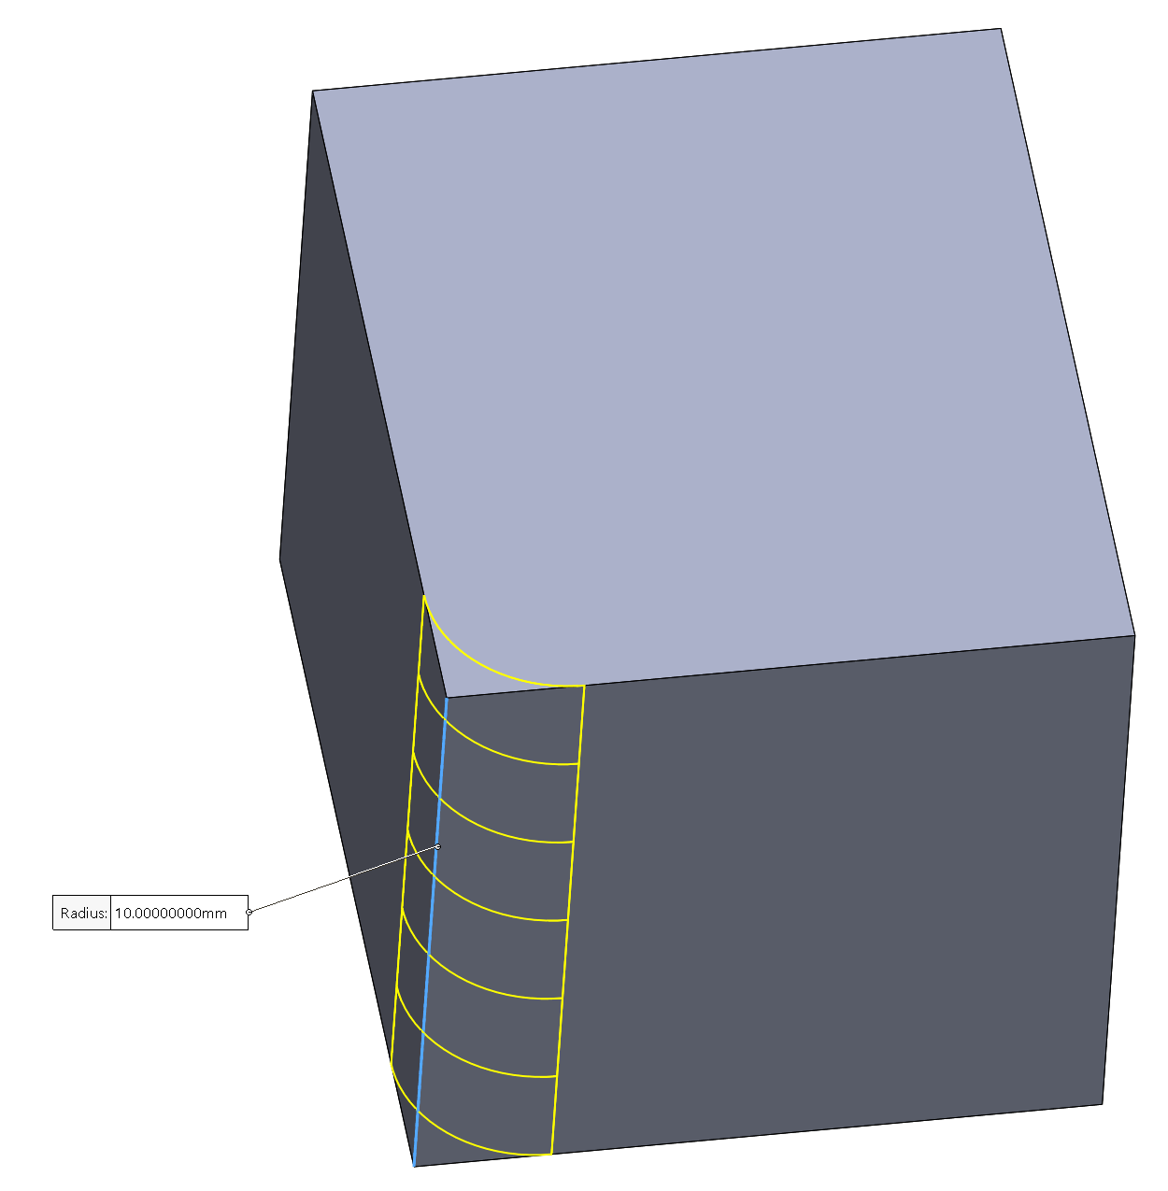
Fillet in Feature Not Sketch if Possible

Slide 13
Assembly
Origin plane mates (especially first part)
If possible, mate all components to one or two fixed references
Long chains of components take longer to solve and more likely to get errors.
Do not create loops for mates
Fully define the position of each part in assembly, unless visualization of motion needed for certain parts
Option: use mechanical mates
Patterns, not multiple same parts if possible (greatly reduce computing power needed)
Lock rotation on cylindrical mate if you don't need rotation

Slide 14
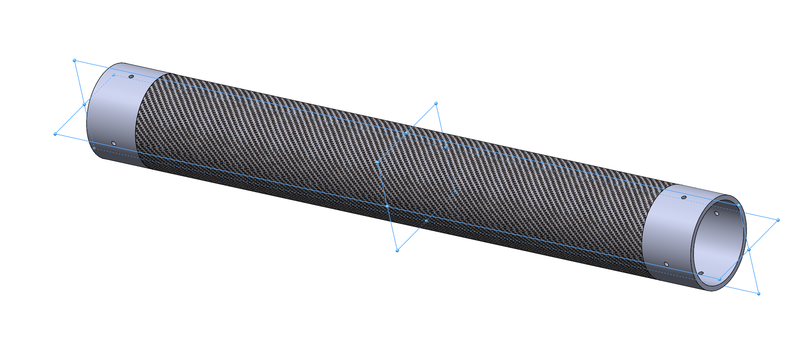
Put Origin as Mount Location
Notes:
Float first, and re-mate it

Slide 15
Use Component Patterns
Demonstration

Slide 16
Small trick for assembling: Copy with mates
Demonstration

Slide 17
Reference
http://help.solidworks.com/2018/English/SolidWorks/sldworks/c_Best_Practices_for_Mates_SWassy.htm?verRedirect=1
https://blog.alignex.com/10-large-assembly-best-practices-in-solidworks
https://forum.solidworks.com/thread/183132
https://petercad.com/category/solidworks-best-practices/
https://www.solidsolutions.co.uk/solidworks/tutorial-videos/top-down-modelling-best-practice.aspx
Robotics Institute, CMU. Design & CAD Best Practices

Slide 18
Gear Basics
李岱峰
2020.07.22

Slide 19
Content
Types of gear
Calculate gear transmission
渐开线 Involute curves
Nomenclature/Terminology
SW TOOLBOX
插件

Slide 20
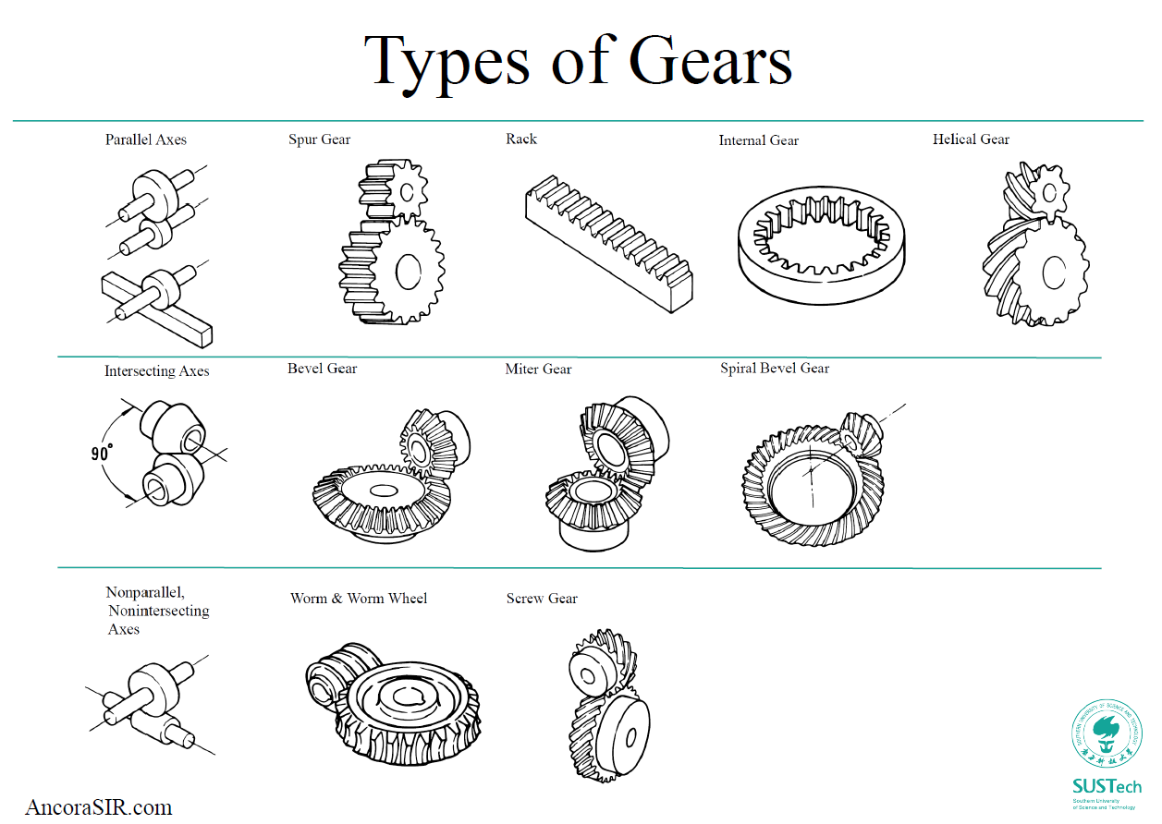

Slide 21
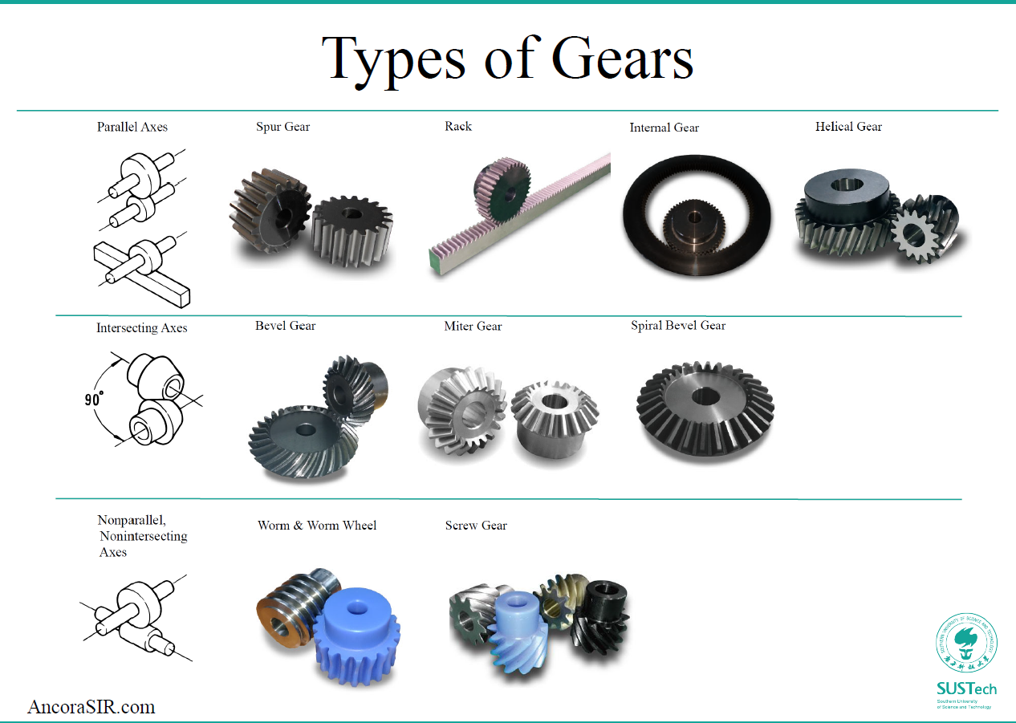

Slide 22
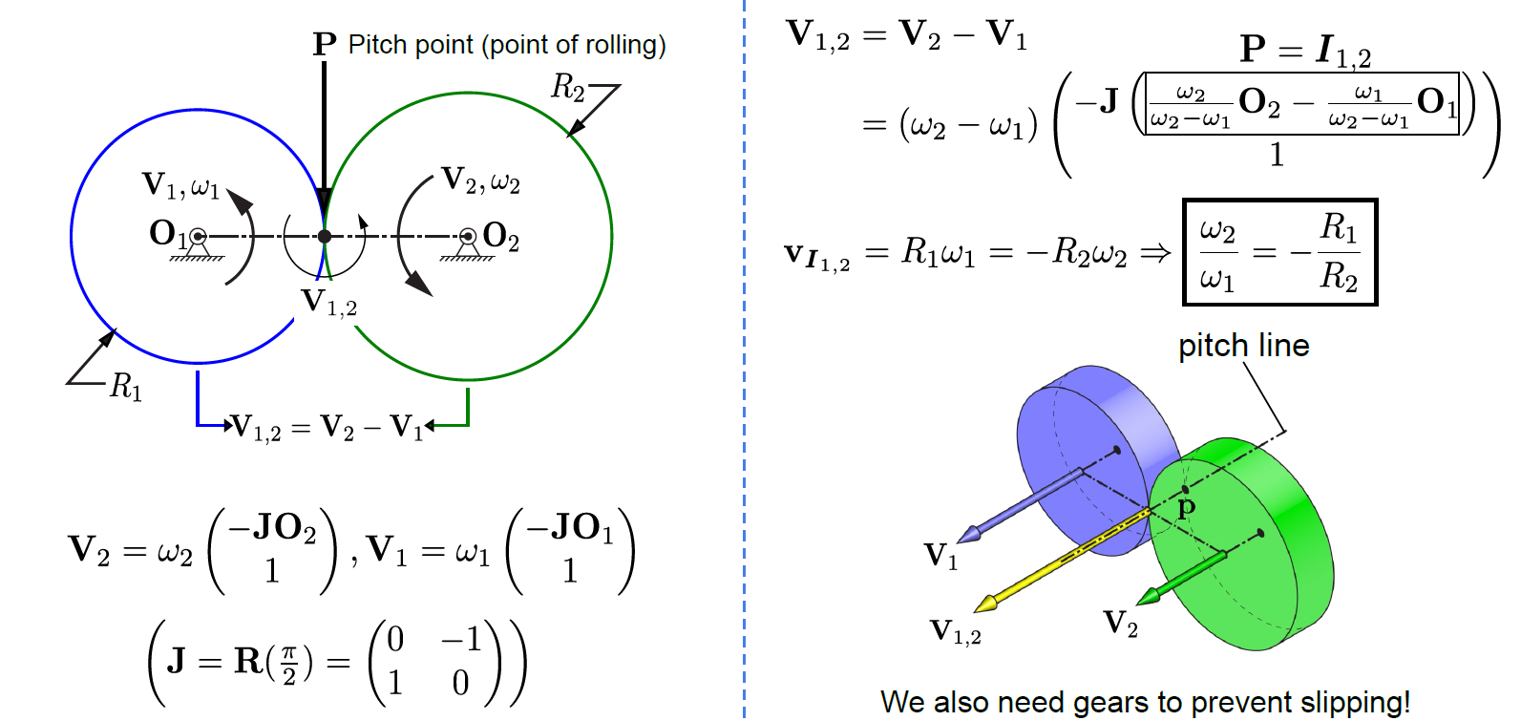
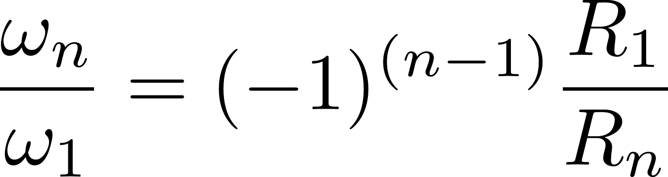
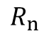
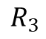
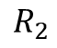
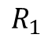
Calculate gear transmission
节点
$$R_{3}$$
$$R_{1}$$
$$R_{2}$$
$$R_{n}$$
Notes:
中间的两点就叫pitch point

Slide 23
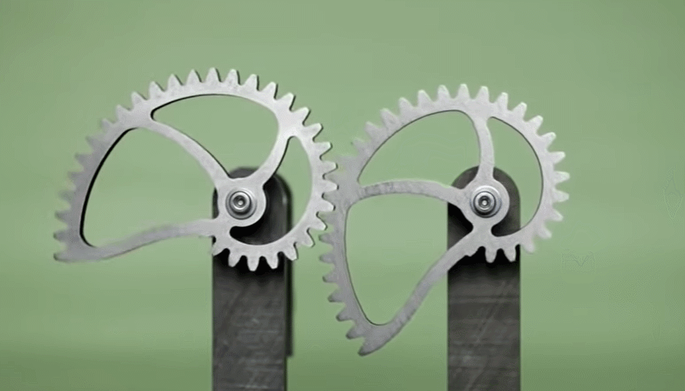
If the pitch point moves, then the angular speed of the driven gear changes
Notes:
Pitch point要不变

Slide 24
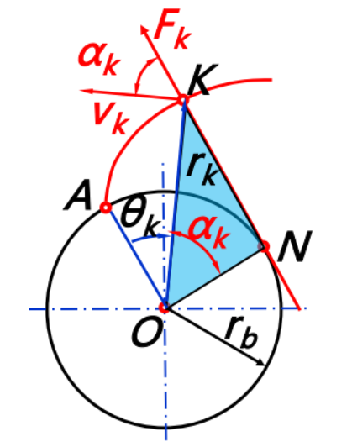
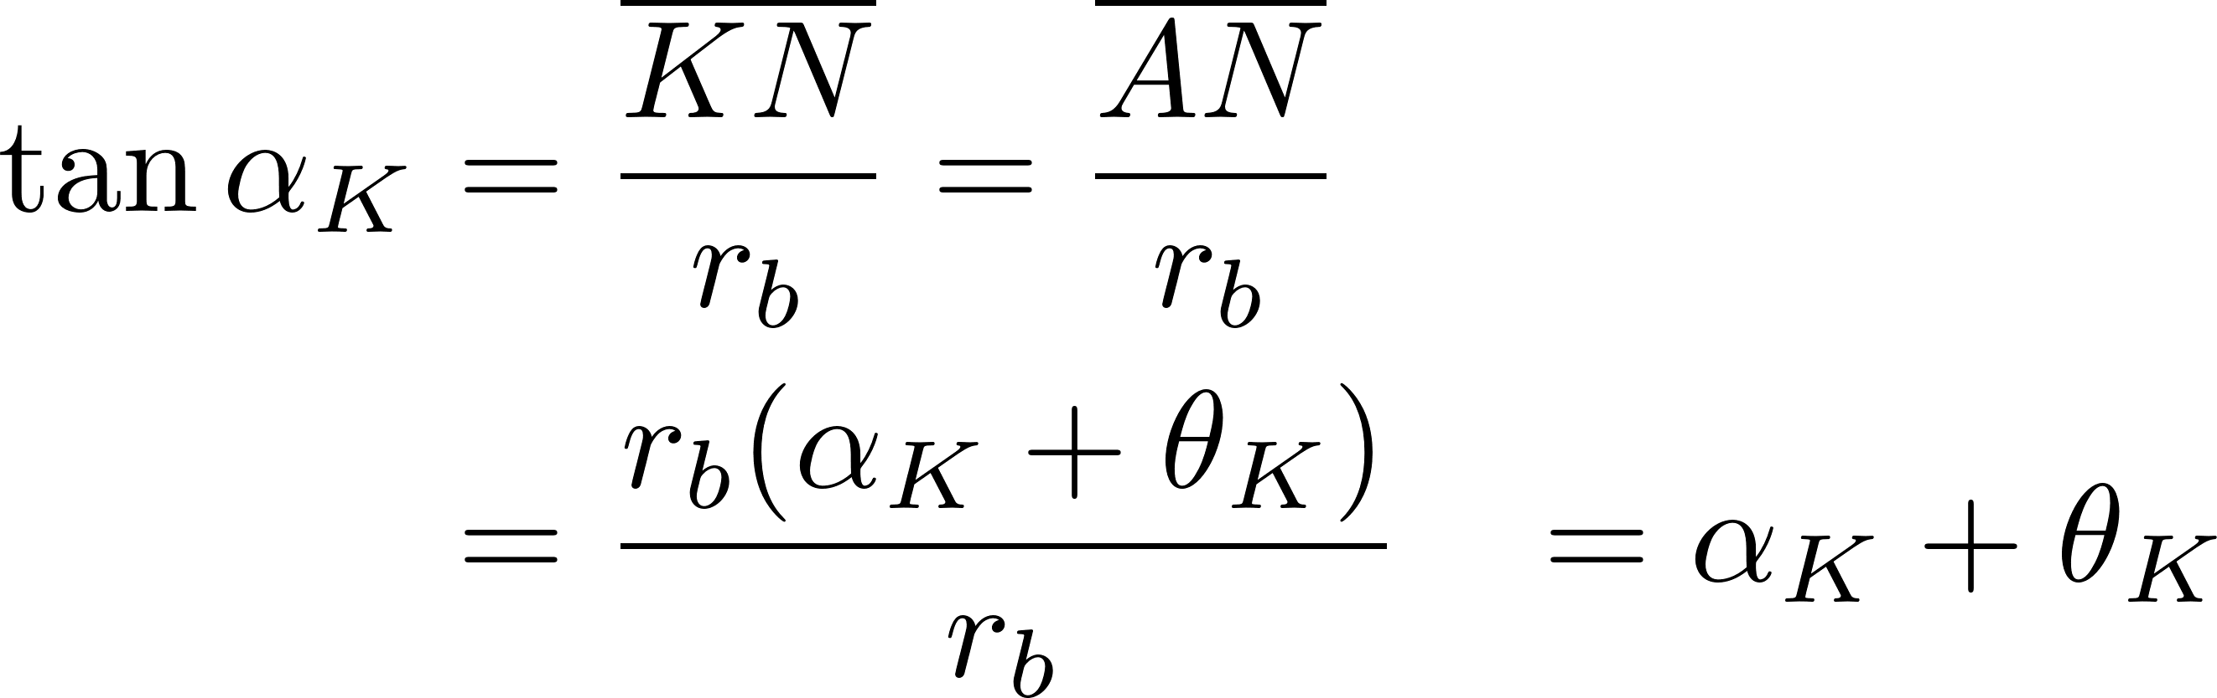
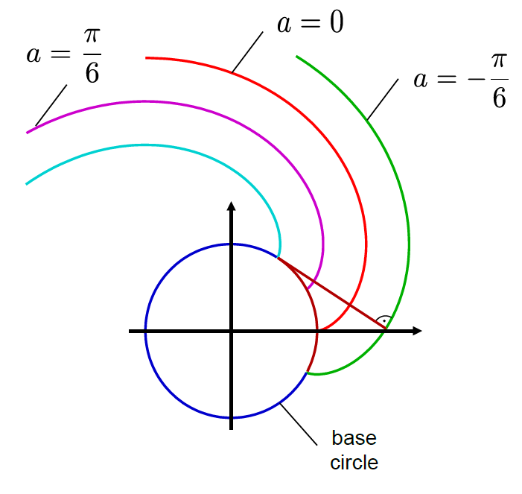
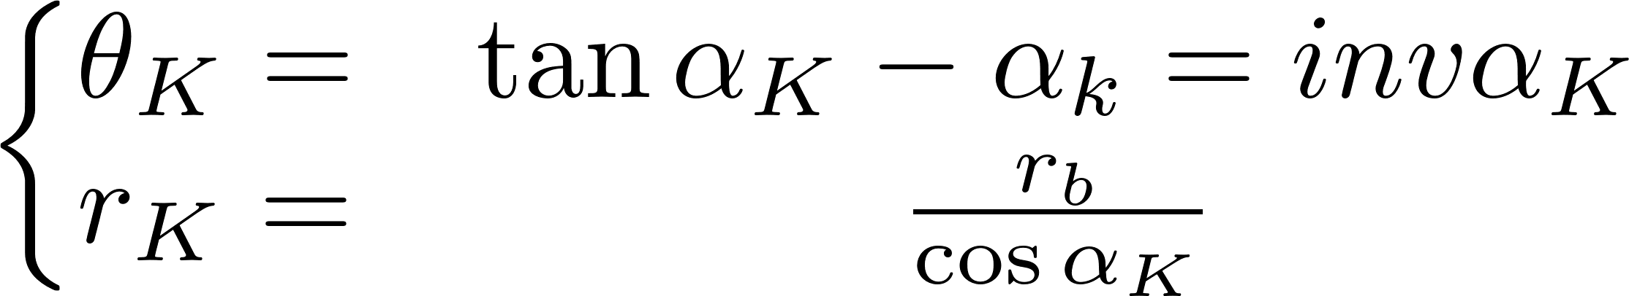

渐开线 Involute curves
极坐标方程
其中：inv$α_{k}$称为渐开线函数
笛卡尔坐标系方程
a代表起始位置
Notes:
所以就生成了一个渐开线齿廓，使得pitch point不变。SW能绘制方程曲线

Slide 25
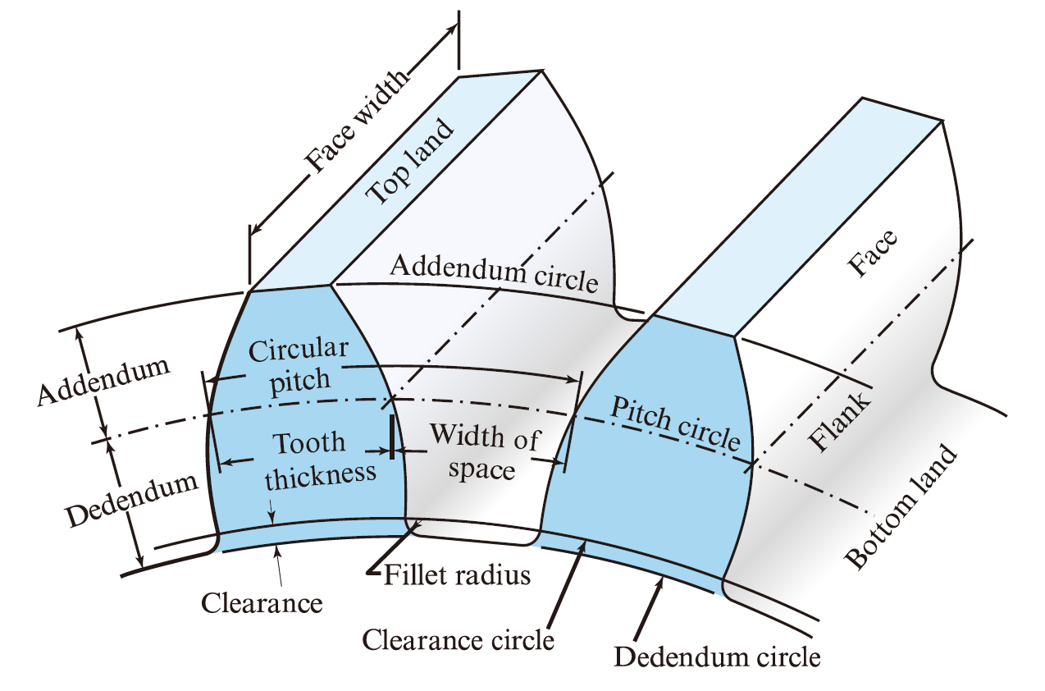
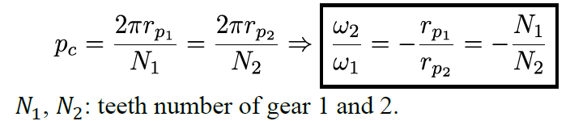
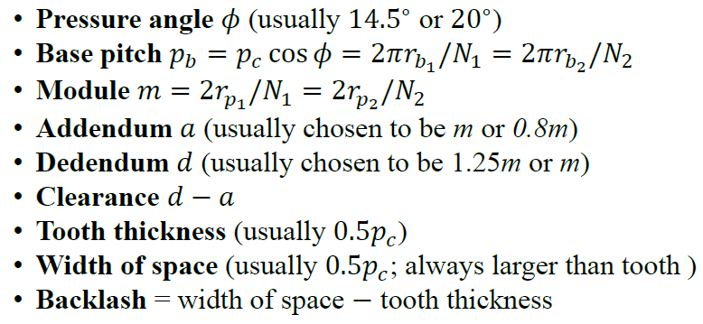
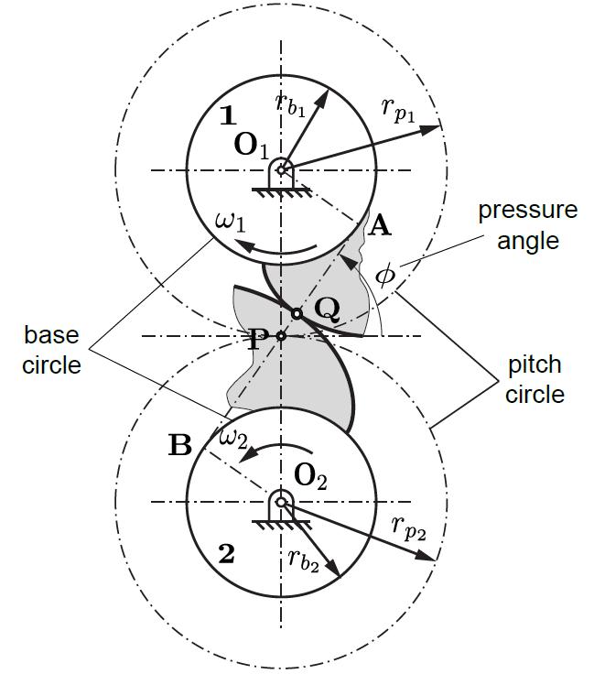
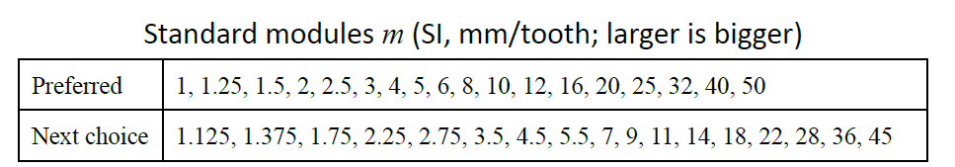
Nomenclature/Terminology
Circular pitch 齿距 $p_{c}$
压力角
基圆齿距
模数
齿顶高
齿根高
空隙
齿厚
基圆
节圆

Slide 26
演示：SW Toolbox和今日制造插件

Slide 27
Reference
中国大学MOOC，西安交通大学，机械设计基础：https://www.icourse163.org/course/XJTU-1001595002?tid=1206706204
SUSTech ME303 Introduction to Mechanical Design, Chaoyang Song: https://ancorasir.com/?page_id=2159
SUSTech SDM232 Mechanical Design and Manufacturing, Yuanqing Wu.
SW插件，今日制造下载：http://www.maidiyun.com/download/softinfo.aspx?id=1&tdsourcetag=s_pctim_aiomsg。相关介绍on bilibili：https://www.bilibili.com/video/BV1dT4y1J7eM?t=110&tdsourcetag=s_pctim_aiomsg

